Slide 1
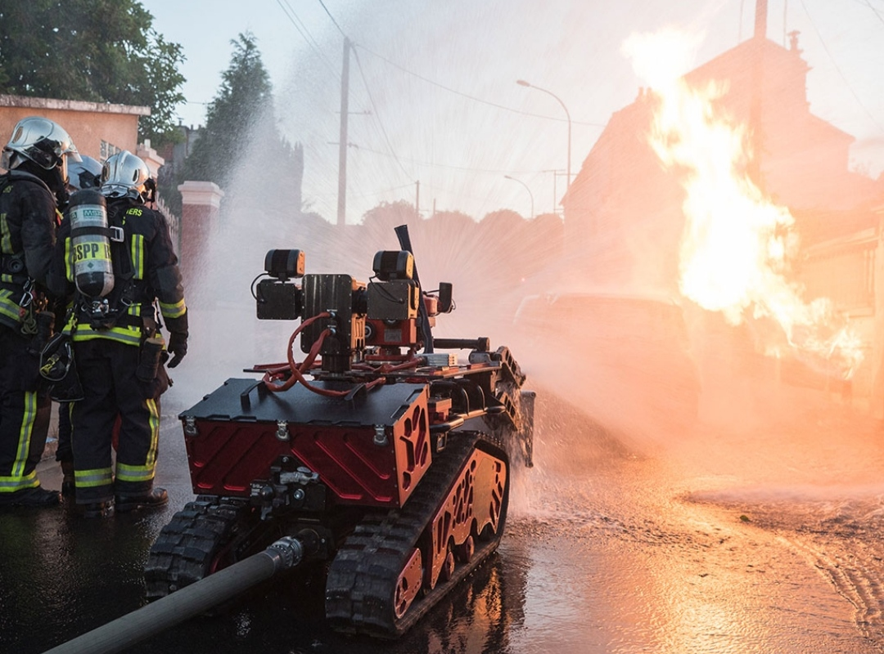
FIRE FIGHTER ROBOT
Presentation by
Yash Gandhat
Vedant kadam
Abha Sonawane
Sanket Vedpathak

Slide 2
Vision:
To inculcate competence and productive professionalism in instrumentation technocrats to face the current and future challenger of technological development
Mission:
1) Technical Skills - To promote innovative and original thinking in the minds of budding engineers to face the challenges of future.
2) Overall Development - To inculcate value-based, socially committed professionalism amongst the students.
3) Research - To facilitate research opportunities to faculty as well as students in multidisciplinary field

Slide 3
Introduction
In this project, we will learn how to build a simple robot using Arduino that could move towards the fire and pump out water around it to put down the fire. It is a very simple robot that would teach us the underlying concept of robotics.

Slide 4
Objective of project
According to National Crime Records Bureau (NCRB), it is estimated that more than 12,748 people died in 2018 because of fire accidents in India 2018. Even though there are a lot of precautions taken for Fire accidents, these natural/man-made disasters do occur now and then. In the event of a fire breakout, to rescue people and to put out the fire we are forced to use human resources which are not safe. the advancement of technology especially In Robotics, it is very much possible to replace humans with robots for fighting the fire. This would improve the efficiency of fire-fighters and would also prevent them from risking human lives.

Slide 5
Components:-
COMPONENTS | QUANTITY
Arduino UNO | 1
Fire Sensor | 3
Servo Motor | 1
L293D Motor Driver | 1
Small Breadboard | 1
Robot Chassis | 1
Wheel | 2
Connecting Wires | As Required
Small Can | 1
Pump | 1

Slide 6
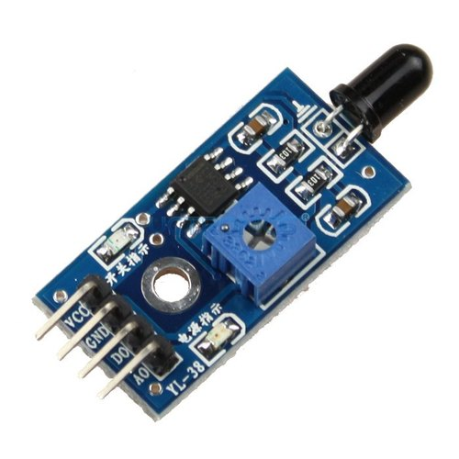
Fire sensor:
The IR flame sensor is used to detect the presence of fire or other infrared source (Flame or a light source of a wavelength in the range of 760 nm to 1100 nm can be detected). It can be used in fire fighting robot or heat seeking robot.
Features
Small and compact in size
Adjustable threshold value
2 state binary output (logic high and low)
Easy mounting with a screw hole

Slide 7
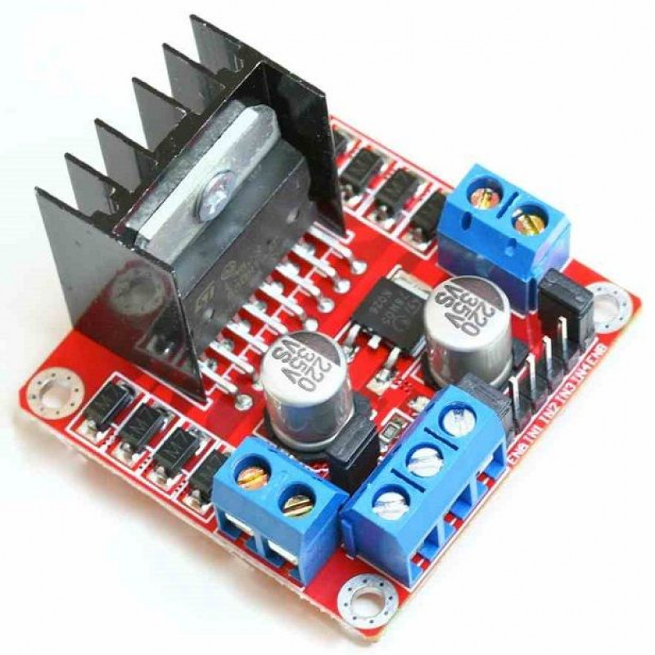
Motor driver ic
L293D motor driver Specifications:
Supply Voltage Range 12V
36V Output current capability per driver
Separate Input-logic supply
It can drive small DC-geared motors, bipolar stepper motor.
Pulsed Current 1.2-A Per Driver
Thermal Shutdown
High-Noise-Immunity Inputs

Slide 8
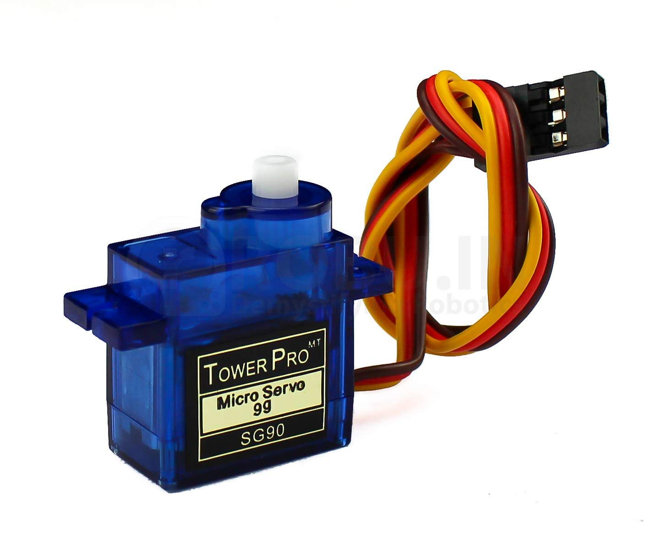
Servomotor:-
A servomotor (or servo motor) is a rotary actuator or linear actuator that allows for precise control of angular or linear position, velocity and acceleration.
Servomotors are used in applications such as robotics, CNC machinery, and automated manufacturing.

Slide 9
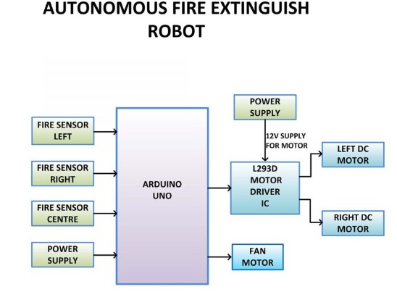
Block diagram:-

Slide 10
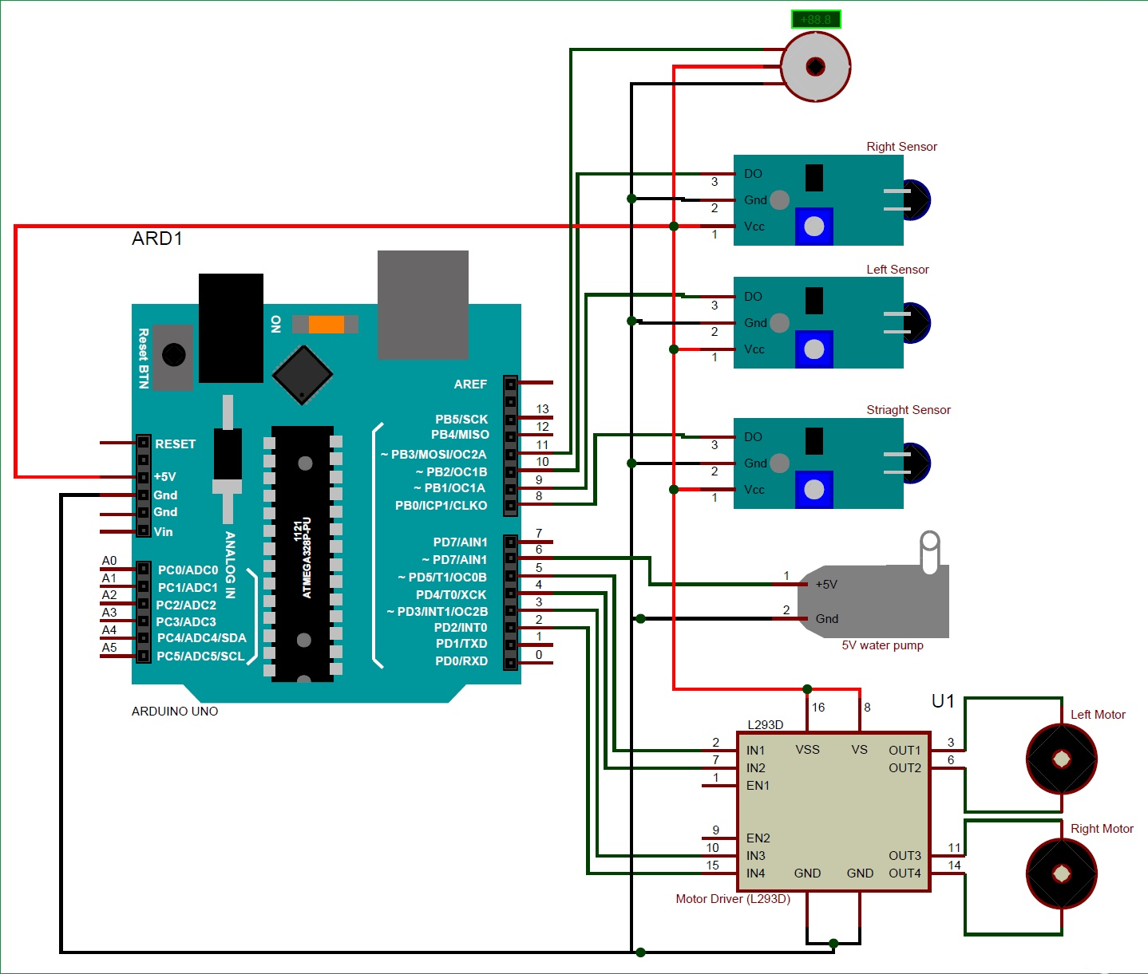
Circuit diagram:-

Slide 11
Advantages :-
It can be used in server room.
Extinguishes fire where probability of explosion is high.
Usable in power plant control rooms, captain bridges, flight control centres.
Disaster area monitoring and rescue.
It can work where human can’t reach easily due some human disabilities such as sustaining at temperature beyond the limits of human limits.

Slide 12
Conclusion:-
In this project we aim to reduce the effect of fire accidents which usually start from small flame. Therefore people's life and money would be saved. The Robot can successfully find and reach at the point of fire.

